Slide 1
SQL Data Warehouse
Building a modern data warehouse with SQL Server, Including ETL Process, Data Modeling and Analytics.
This project demonstrates a comprehensive data warehousing and analytics solution, from building a data warehouse to generating actionable insights. Designed as a portfolio project, it highlights industry best practices in data engineering and analytics.

Slide 2
Project Requirements
Objective:
Develop a modern data warehouse using SQL Server to consolidate sales data, enabling analytical reporting and informed decision-making.
Specifications:
Data Sources: Import data from two source systems (ERP and CRM) provided as CSV files.
Data Quality: Cleanse and resolve data quality issues prior to analysis.
Integration: Combine both sources into a single, user-friendly data model designed for analytical queries.
Scope: Focus on the latest dataset only; historization of data is not required.
Documentation: Provide clear documentation of the data model to support both business stakeholders and analytics teams.

Slide 3
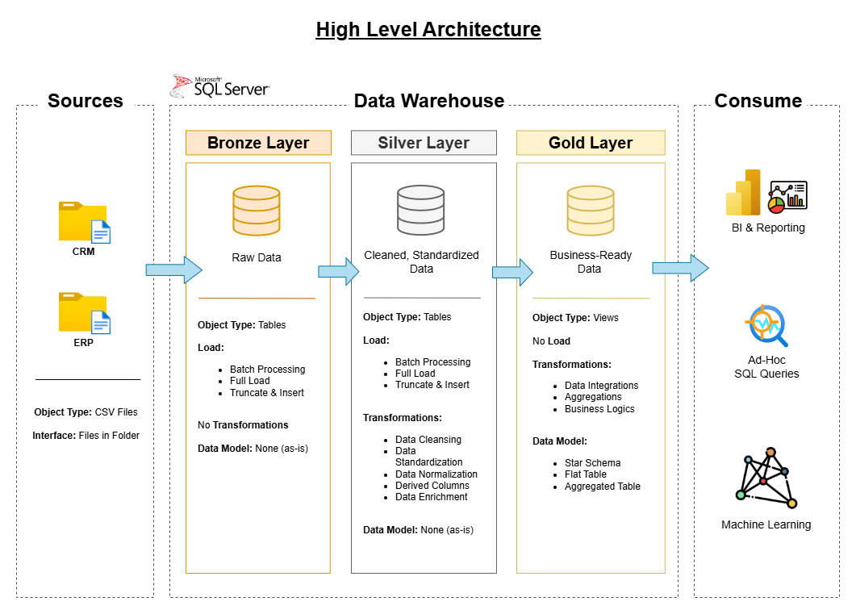
Data Architecture
The data architecture for this project follows Medallion Architecture Bronze, Silver, and Gold layers:
Bronze Layer: Stores raw data as-is from the source systems. Data is ingested from CSV Files into SQL Server Database.
Silver Layer: This layer includes data cleansing, standardization, and normalization processes to prepare data for analysis.
Gold Layer: Houses business-ready data modeled into a star schema required for reporting and analytics.

Slide 4
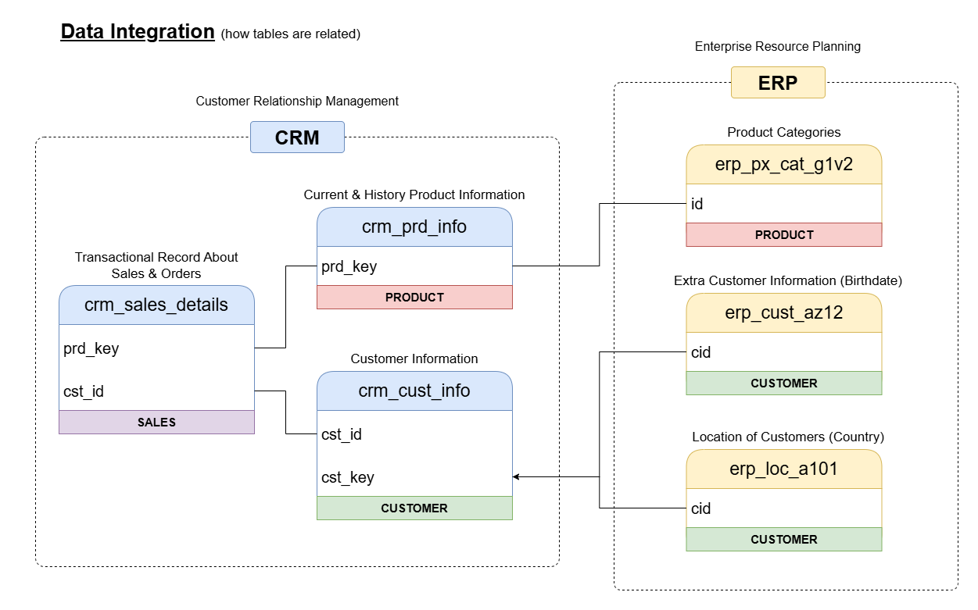
Data Integration
This data integration diagram illustrates how the tables are interconnected, highlighting primary keys and their corresponding foreign keys across related tables.
It provides clear visibility into the database structure, making it easier for anyone working with the system to understand relationships and dependencies.
Additionally, it serves as a valuable reference when designing and implementing a modern SQL-based data warehouse.

Slide 5
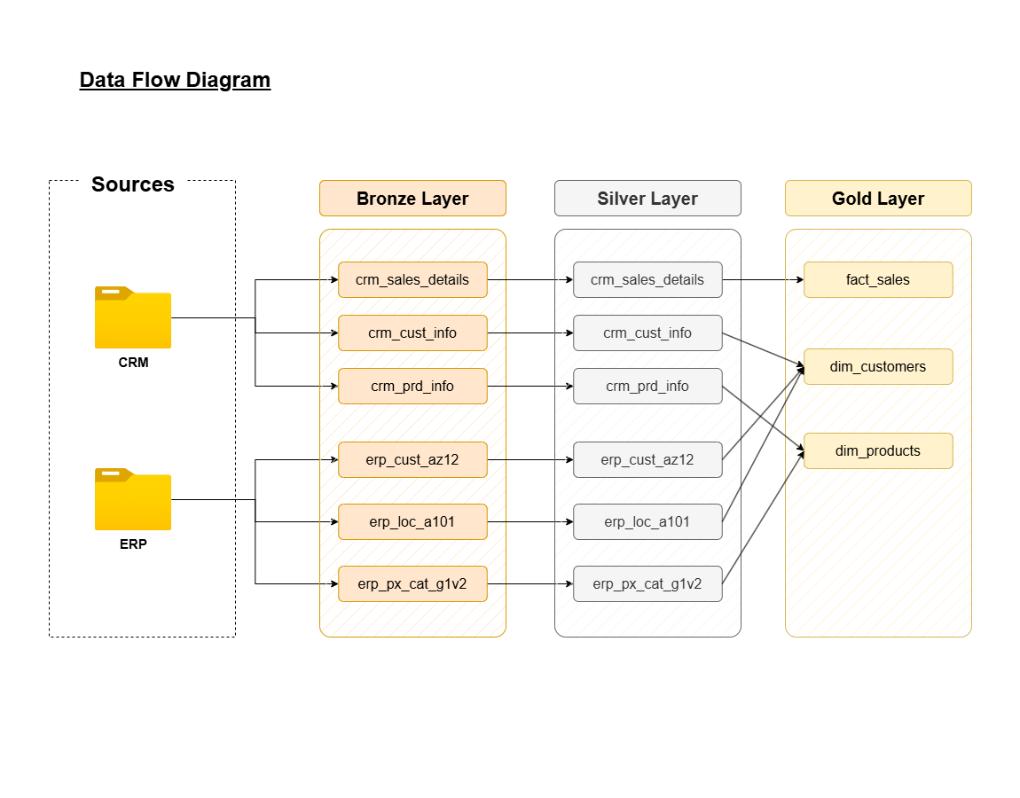
Data Flow
This data flow diagram provides a clear overview of how information moves from source systems into the data warehouse.
Data is first ingested from CRM and ERP systems into the Bronze Layer, where raw datasets are stored in their original form.
These datasets are then standardized, cleansed, and structured in the Silver Layer, ensuring consistency and improving data quality.
Finally, the refined data is transformed into analytical models within the Gold Layer, including fact and dimension tables such as fact_sales, dim_customers, and dim_products.

Slide 6
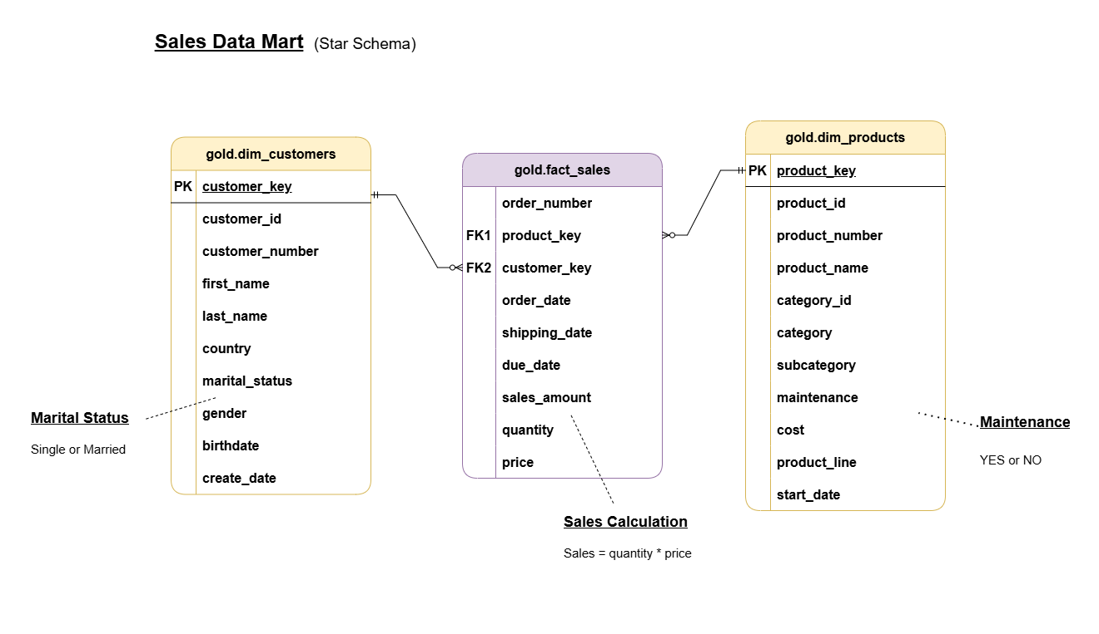
Sales Data Model Star Schema
The Sales Data Mart uses a Star Schema to organize sales data for fast and efficient reporting. The fact table stores core sales metrics like order details, quantity, price, and total sales.
Customer attributes such as country, gender, and marital status enhance analysis by enabling customer segmentation and behavioral insights.
Product details like category, product line, and maintenance status help track product performance and support business decision-making.

Slide 7
Project Handwritten Notes

Slide 8
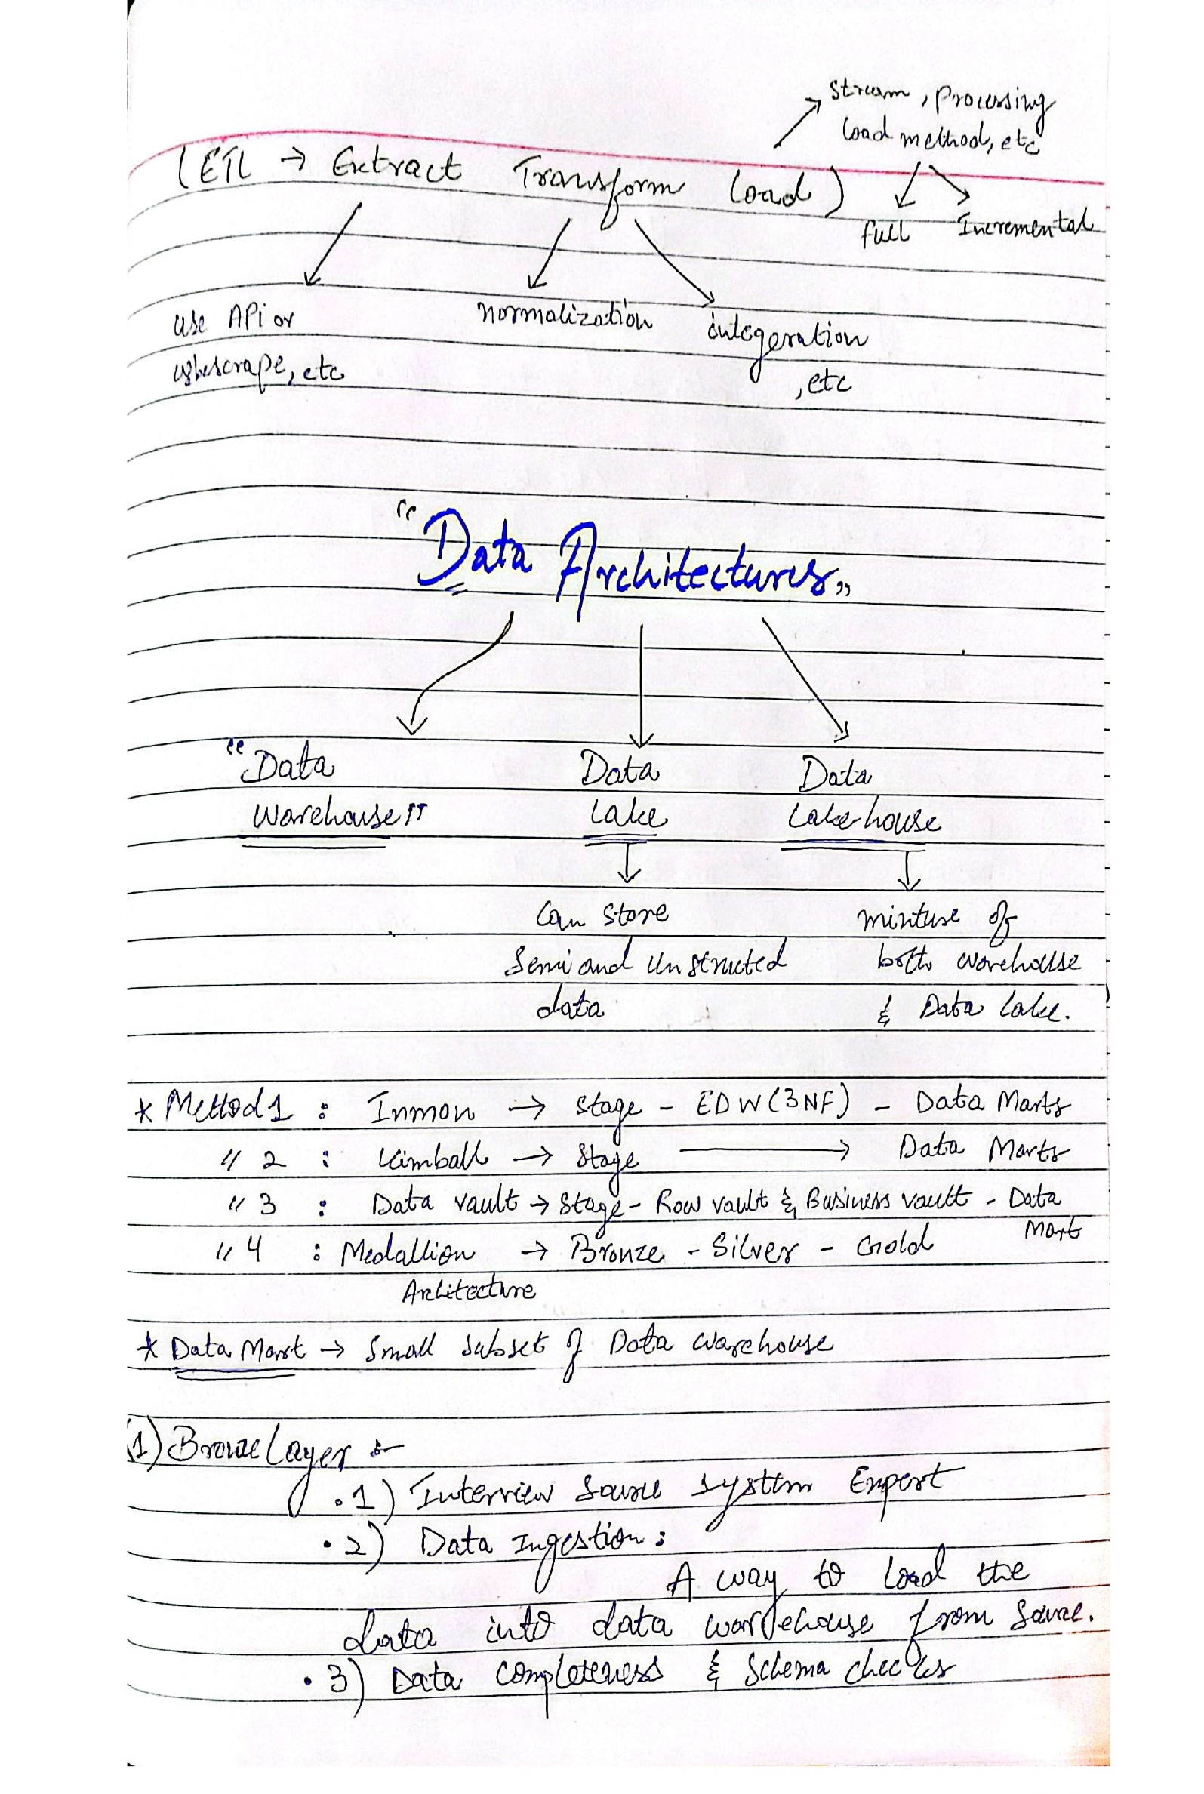
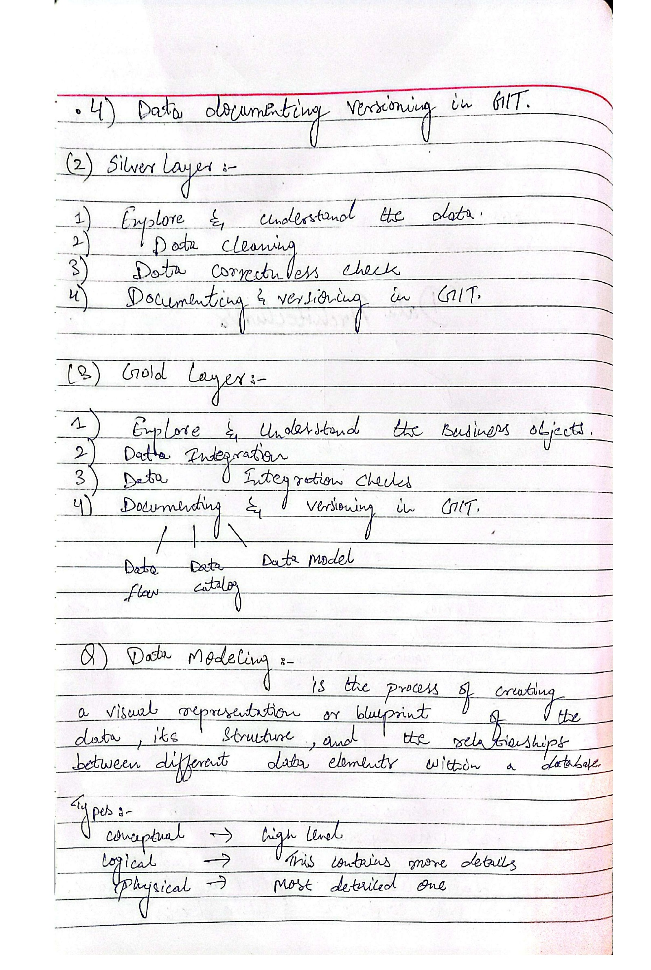
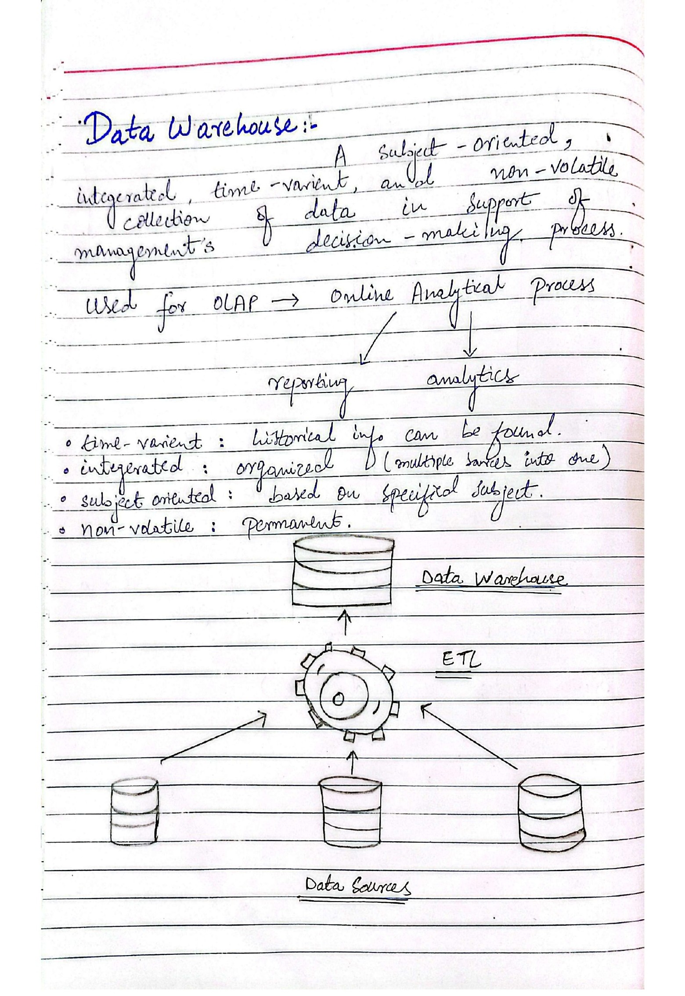

Slide 9
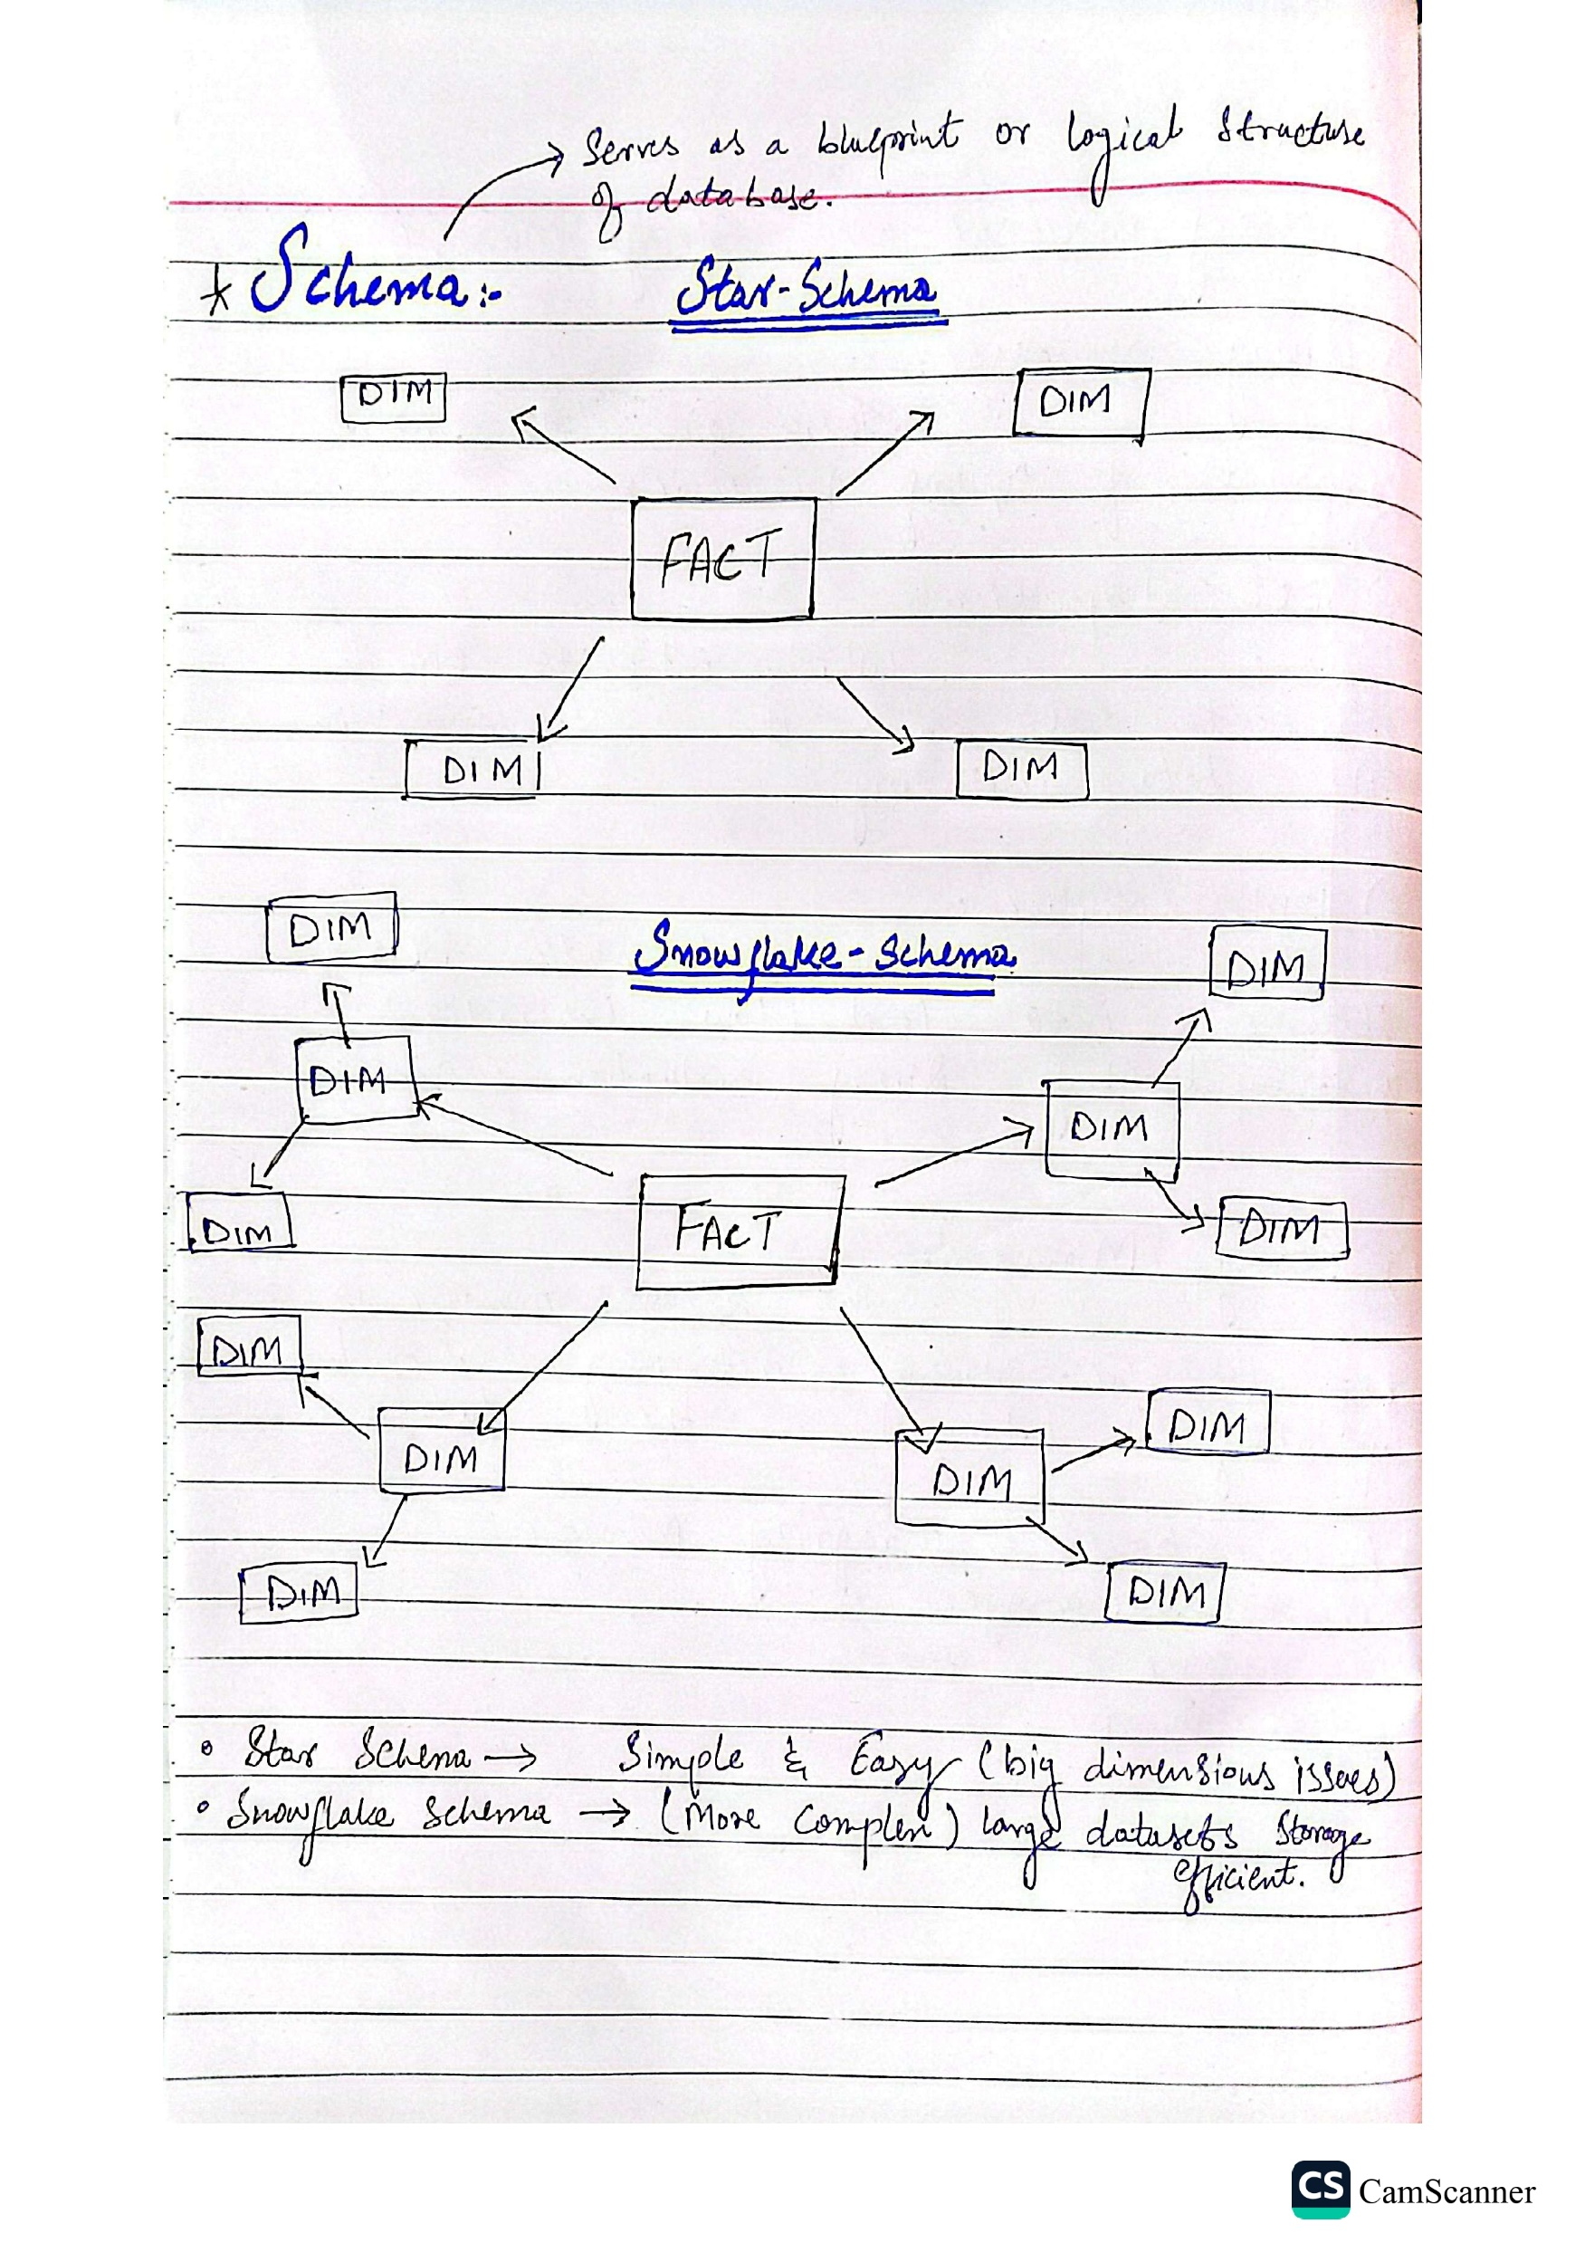
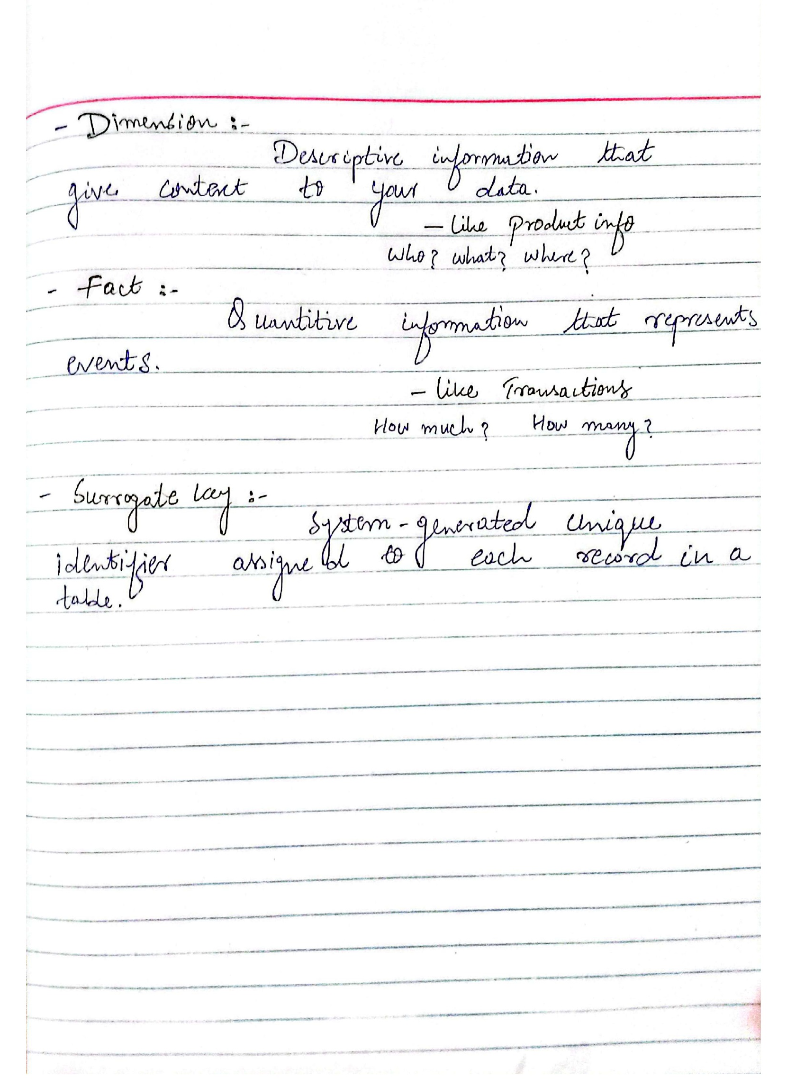

Slide 10
Conclusion
As a Data Analyst and aspiring Data Scientist, working on this Data Warehouse and Analytics solution strongly aligned with my academic coursework especially Database Management Systems theory, allowing me to apply nearly all key concepts learned throughout the semester.
From architecting a modern Medallion-based data warehouse to building ETL pipelines, designing fact/dimension models, and producing analytical insights, this project strengthened my understanding of SQL development, data modeling, and enterprise-level data engineering practices.
Overall, this project showcases my capability to design structured data architectures, integrate multiple data sources, and develop scalable analytical solutions. It reflects both my academic growth and professional readiness for roles in data analytics, data engineering, and data-driven decision-making.
For complete project details, scripts, and implementation files, visit my GitHub repository:
GitHub: https://github.com/ShehrazSarwar/SQL-Data-Warehouse-Project

